Slide 1
Implementing a Flocking algorithm in C++
Dr David White - Course DNA

Slide 2
Introduction
Requirements:
A working knowledge of C++
A knowledge of 3D and 2D vectors
Not required:
Graphics programming skills (though these are beneficial)

Slide 3
Introduction
What you will achieve on this course
Artificial Life - an introduction:
The Flocking Algorithm
A Demonstration
A Walkthrough of the code

Slide 4
What you will achieve
An understanding of the basic principles of Artificial Life
An understanding of Flocking - widely used in games
Development of a flocking simulation in C++
Skeletal code is provided
A worksheet will provide the steps to achieve the goal
An understanding of how to improve the model
How to improve efficiency
How to improve the look
How to add realism to the model

Slide 5
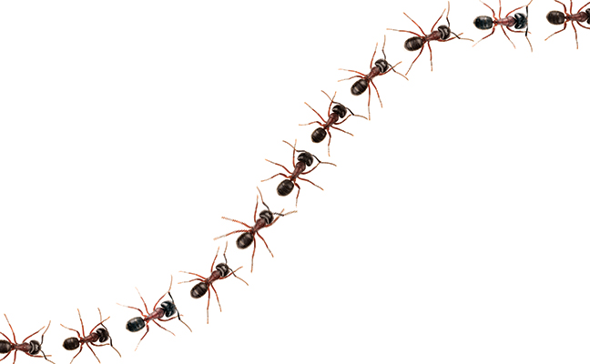
Artificial Life
Artificial life: understand life by replicating it in a simulation
Based on simplifying assumptions.
Or… Using Computer Simulation to test out biological ideas.
We have a theory on why some biological mechanism occurs...
If we simulate it - does the same thing happen?

Slide 6
Artificial Life
Some simple terminology to remember!
A-Life = Artificial Life
A-Life → complexity from the bottom up
agents (fish / ants / people) control themselves
Not (usually…) from the top down
No 'manager' with some knowledge of all agent states tells each agent what to do

Slide 7
Artificial Life
Complexity - the level of understanding of state
Emergent Behaviour - behaviour which emerges which hasn't been directly programmed

Slide 8
Artificial Life
Systems in A-Life have 5 general properties.
1. A set of SIMPLE instructions about how agents interact.
2. No ‘director’ to control the actions of the agents.
3. Each instruction defines how agents respond to the environment.
4. No rules (at agent level) that direct global behaviours of the system.
5. Emergence is on a higher level than the individuals.

Slide 9
Emergent Behaviours
With simple, local interactions the collective:
Acquires properties, dynamic and global behaviours that are not present or predictable in individuals.
https://youtu.be/ix66tQ93bdU?t=92
These behaviours will seem organised and directed.
As though controlled by a higher power.
Result is complex, self-organising, adaptive systems.
That carry out intricate tasks and behaviours.

Slide 10
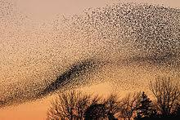
Flocking
Video: https://video.nationalgeographic.com/video/short-film-showcase/00000158-457d-d0be-a1dc-4f7f8e650000

Slide 11
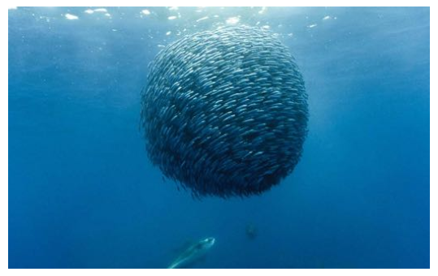
Flocking

Slide 12
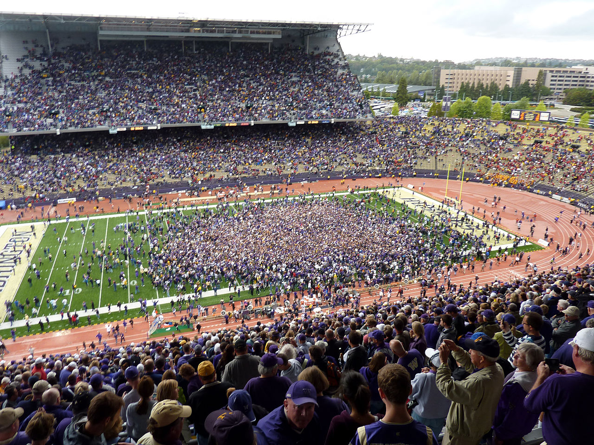
Flocking

Slide 13
Flocking
Flocking - how to generate these fluid forms?
Method 1: The top down approach
A flock manager
Contains a list of 'boids'
Decide where the boids should flock
Create a list of places each boid should be, place each boid
Move the flock position around
each time, creating a new position for each boid
Perhaps add some randomness
Is this realistic?
Would it look realistic? fluid?
Is it scalable? Can we add on the fly?
Does it have the apparent complexity of real-life flocking?
Would the flock respond to change (e.g. a predator) realistically?

Slide 14
Flocking
Method 2: The bottom up approach
From Craig Reynolds 1987 simulation: boids
Separation - avoid crowding neighbours (short range repulsion)
Alignment - steer towards average heading of neighbours
Cohesion - steer towards average position of neighbours (long range attraction)

Slide 15
Flocking
Benefits from the decentralised approach
Recovery
A disruption to the flock (e.g. a predator scattering the flock) will lead to the flock recovering
Reactivity
Fast ability to change direction without losing the three flock properties
Scalability
Similar behaviour is observed regardless of swarm size, at any time
Adding boids is trivial

Slide 16
Demonstration

Slide 17
Improvements to the model
This session: practice with simple constant movement / instant directional changes
Future work: how can we improve the movement?
Better models (not cubes!)
Visible rotational alignment
Improved avoidance
Better priorities
Obstacle avoidance
Newtonian particle physics

Slide 18
Improvements to the model
How can we improve the efficiency?
Multi-processing
On the CPU - multi threading
A separate thread for calculating neighbours
Separate threads for groups of boids
On the GPU
Compute Shaders

Slide 19
A walkthrough of the code.
The project
main.cpp
DrawableGameObject
math functions
other functions

Slide 20
Image and Video Sources
National Geographic
Wikipedia

